Slide 1
HSPC 2023 Solution Sketches

Slide 2
Problem | Title
P1 | Relatively Prime Floating Mountains
P2 | Tsireya's Number Play
P3 | Interleaved Omangi Messages
P4 | Woodsprites’ Patterns
P5 | Unstable Floating Mountains
P6 | Path-Breaker
P7 | Akula Topple
P8 | Hidden Pathways
P9 | Starfish

Slide 3
P1 – Relatively Prime Floating Mountains
Problem: All pairs of elements of a given set relatively prime?
Solution: Two nested loops to iterate/test all pairs.
boolean allPairsRelativelyPrime(int[] d) {
for (int i = 0; i < d.length; i++)
for (int j = i+1; j < d.length; j++)
if (gcd(d [i], d [j]) != 1) return false
return true;
}

Slide 4
P2 – Tsireya's Number Play
Problem: Given a number and 2 digits, make the largest number
Solution: Iterate through the digits. Find first digit smaller than new digit and insert before it. Otherwise insert at end
Example: 987654321 and 7, 0: Answer: 98776543210
Java notes:
Convert integer into a string of digits: Integer.toString(n)
Substring of first i symbols: str.substring(0, i)
Remaining substring: str.substring(i)
Insert new digit into string after index i:
str.substring(0, i) + Integer.toString(digit) + str.substring(i)

Slide 5
P2 – Tsireya's Number Play
Find first digit of n smaller than digit, and insert digit before it:
String str = Integer.toString(n) // convert n to string form
boolean inserted = false
for(int i = 0; i < str.length(); i++) {
if( (str.charAt(i) - '0') < digit) { // i-th digit of number < new digit?
str = str.substring(0, i) + Integer.toString(digit) + str.substring(i)
inserted = true; break
}
}
if (!inserted) str = str + Integer.toString(digit) // insert at end
Repeat for both digits

Slide 6
P3 – Interleaved Omangi Messages
Problem: Decrypt string of length n by “unshuffling” every n/k-th character
Solution: Let off = n/k be the offset. Nest two loops. The outer gives the starting character i=0...(off-1) and the inner generates offsets i+0, i+off, i+2∙off, …
String result = ""
int offset = s.length()/k // offset size
for (int i = 0; i < offset; i++) { // start of each group
for (int j = i; j < s.length(); j += offset)
result += s.charAt(j) // take every offset character
}
}

Slide 7
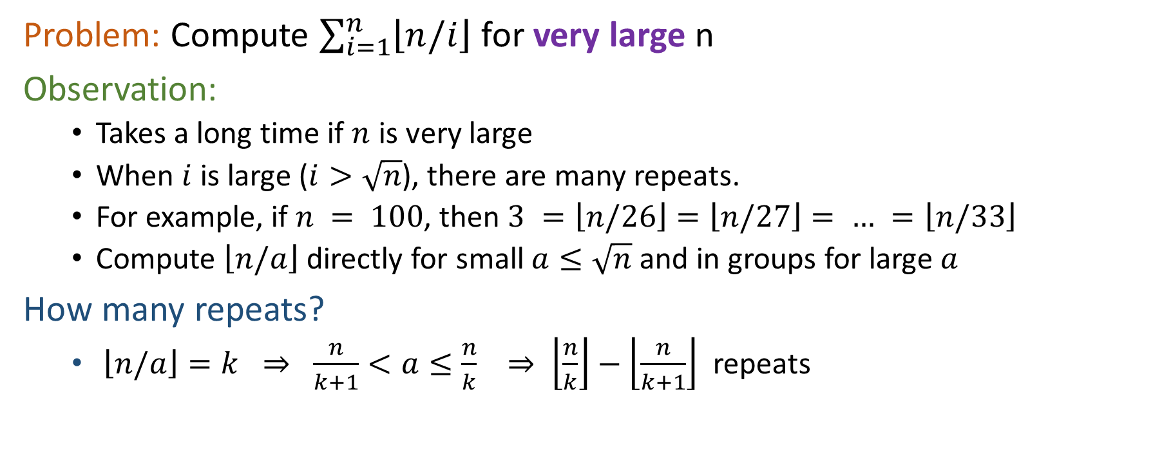
P4 – Woodsprites’ Patterns
Problem: Compute $\sum_{i=1}^{n}{\left\lfloor n/i\right\rfloor }$ for very large n
Observation:
Takes a long time if $n$ is very large
When $i$ is large ($i>\sqrt{n}$), there are many repeats.
For example, if $n = 100$, then $3 =\left\lfloor n/26\right\rfloor =\left\lfloor n/27\right\rfloor = … =\left\lfloor n/33\right\rfloor$
Compute $\left\lfloor n/a\right\rfloor$ directly for small $a≤\sqrt{n}$ and in groups for large $a$
How many repeats?
$\left\lfloor n/a\right\rfloor =k ⇒ \frac{n}{k+1}<a≤\frac{n}{k} ⇒ \left\lfloor \frac{n}{k}\right\rfloor −\left\lfloor \frac{n}{k+1}\right\rfloor$ repeats

Slide 8
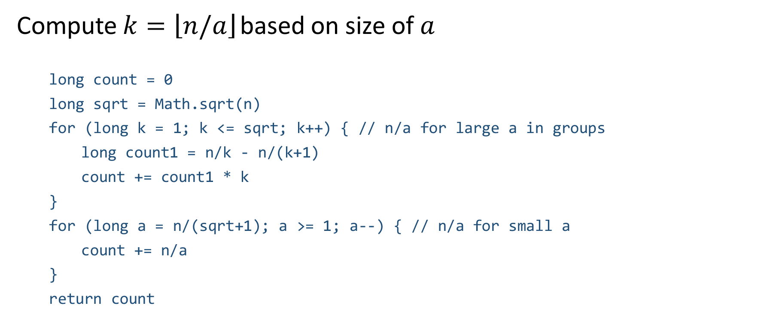
P4 – Woodsprites’ Patterns
Compute $k=\left\lfloor n/a\right\rfloor$ based on size of $a$
long count = 0
long sqrt = Math.sqrt(n)
for (long k = 1; k <= sqrt; k++) { // n/a for large a in groups
long count1 = n/k - n/(k+1)
count += count1 * k
}
for (long a = n/(sqrt+1); a >= 1; a--) { // n/a for small a
count += n/a
}
return count

Slide 9
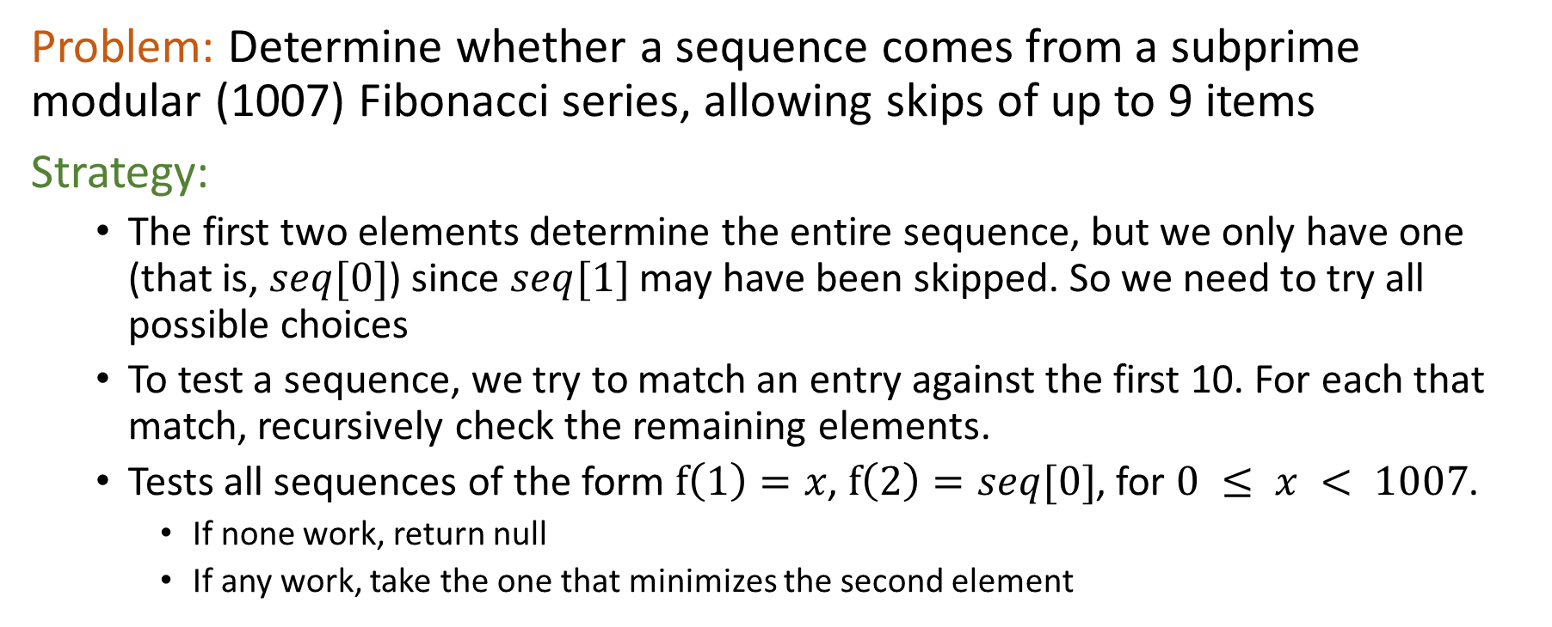
P5 – Unstable Floating Mountains
Problem: Determine whether a sequence comes from a subprime modular (1007) Fibonacci series, allowing skips of up to 9 items
Strategy:
The first two elements determine the entire sequence, but we only have one (that is, $seq[0]$) since $seq[1]$ may have been skipped. So we need to try all possible choices
To test a sequence, we try to match an entry against the first 10. For each that match, recursively check the remaining elements.
Tests all sequences of the form $f\left(1\right)=x$, $f\left(2\right)=seq[0]$, for $0 ≤ x < 1007$.
If none work, return null
If any work, take the one that minimizes the second element

Slide 10
P5 – Unstable Floating Mountains
Test whether a portion of a sequence (seq) matches the sequence f(1)=a, f(2)=b, …
boolean satisfied(int a, int b, int[] seq) { // does seq match Fibonacci with skips?
if(seq.length == 0) return true // empty sequence trivially matches
for(int i = 0; i < 10; i++) { // try all possible skips
int next = largestFactors[(a + b) % 1007] // next element of Fibonacci series
if (next == seq[0]) { // do with match the next item in Fibonacci?
if(satisfied(b, next, seq[1..seq.length-1])) { // yes...recursively check remainder
return true
}
}
a = b; b = next // didn’t match - try next in Fibonacci series
}
return false
}
Precompute largest factors

Slide 11
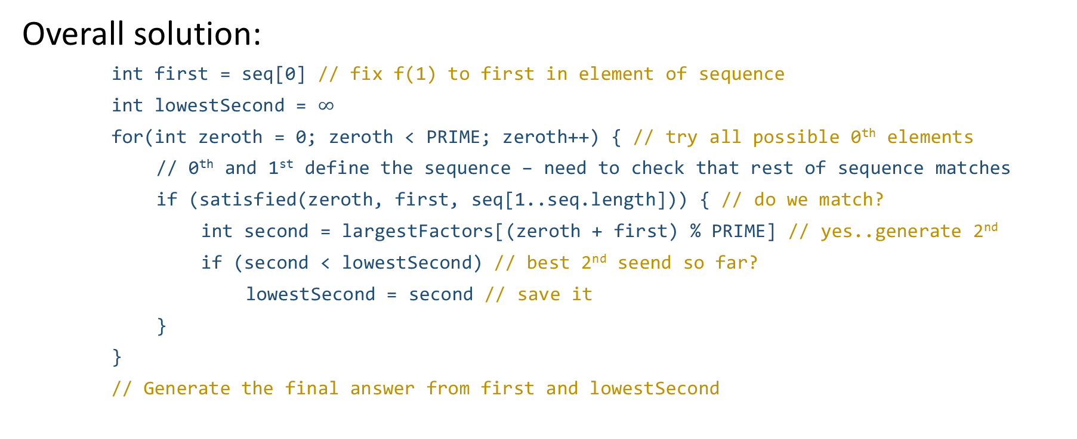
P5 – Unstable Floating Mountains
Overall solution:
int first = seq[0] // fix f(1) to first in element of sequence
int lowestSecond = $∞$
for(int zeroth = 0; zeroth < PRIME; zeroth++) { // try all possible 0th elements
// 0th and 1st define the sequence – need to check that rest of sequence matches
if (satisfied(zeroth, first, seq[1..seq.length])) { // do we match?
int second = largestFactors[(zeroth + first) % PRIME] // yes..generate 2nd
if (second < lowestSecond) // best 2nd seend so far?
lowestSecond = second // save it
}
}
// Generate the final answer from first and lowestSecond

Slide 13
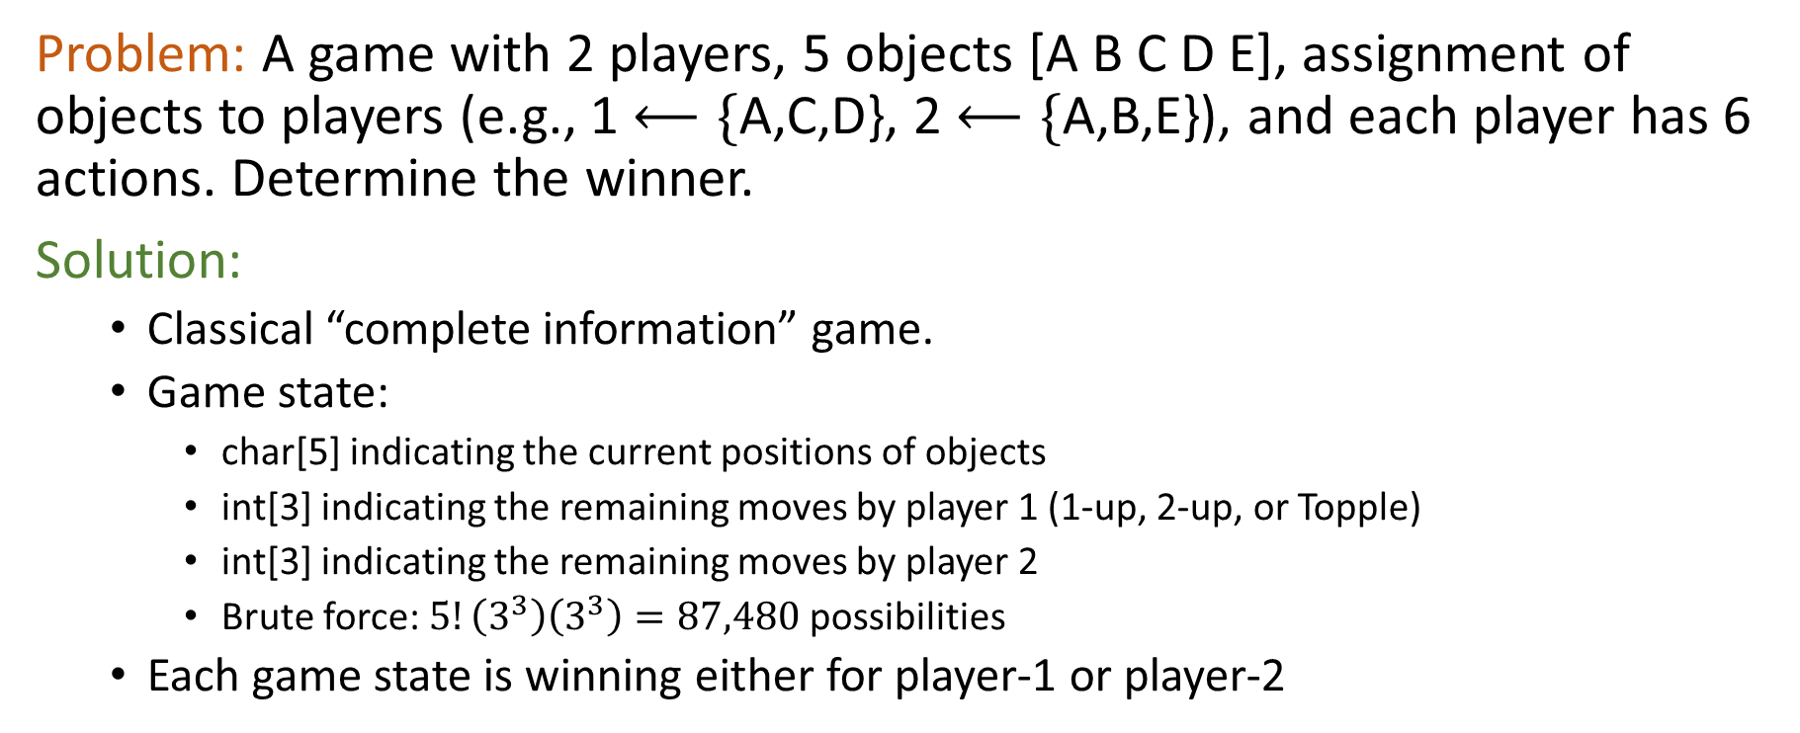
P7 – Akula Topple
Problem: A game with 2 players, 5 objects [A B C D E], assignment of objects to players (e.g., 1 $⟵\{$A,C,D}, 2 $⟵\{$A,B,E}), and each player has 6 actions. Determine the winner.
Solution:
Classical “complete information” game.
Game state:
char[5] indicating the current positions of objects
int[3] indicating the remaining moves by player 1 (1-up, 2-up, or Topple)
int[3] indicating the remaining moves by player 2
Brute force: $5!\left(3^{3}\right)\left(3^{3}\right)=87,480$ possibilities
Each game state is winning either for player-1 or player-2

Slide 14
P7 - Akula Topple
Solution:
Each game state is winning either for player-1 or player-2
There are 12 plays in total (6 apiece for players 1 and 2)
Simulate the game tree, using the set of winning/losing configurations conditioned upon the number of plays remaining in the game.
Use dynamic programming to “memoize” the results, avoiding the exponential blowup of states

Slide 16
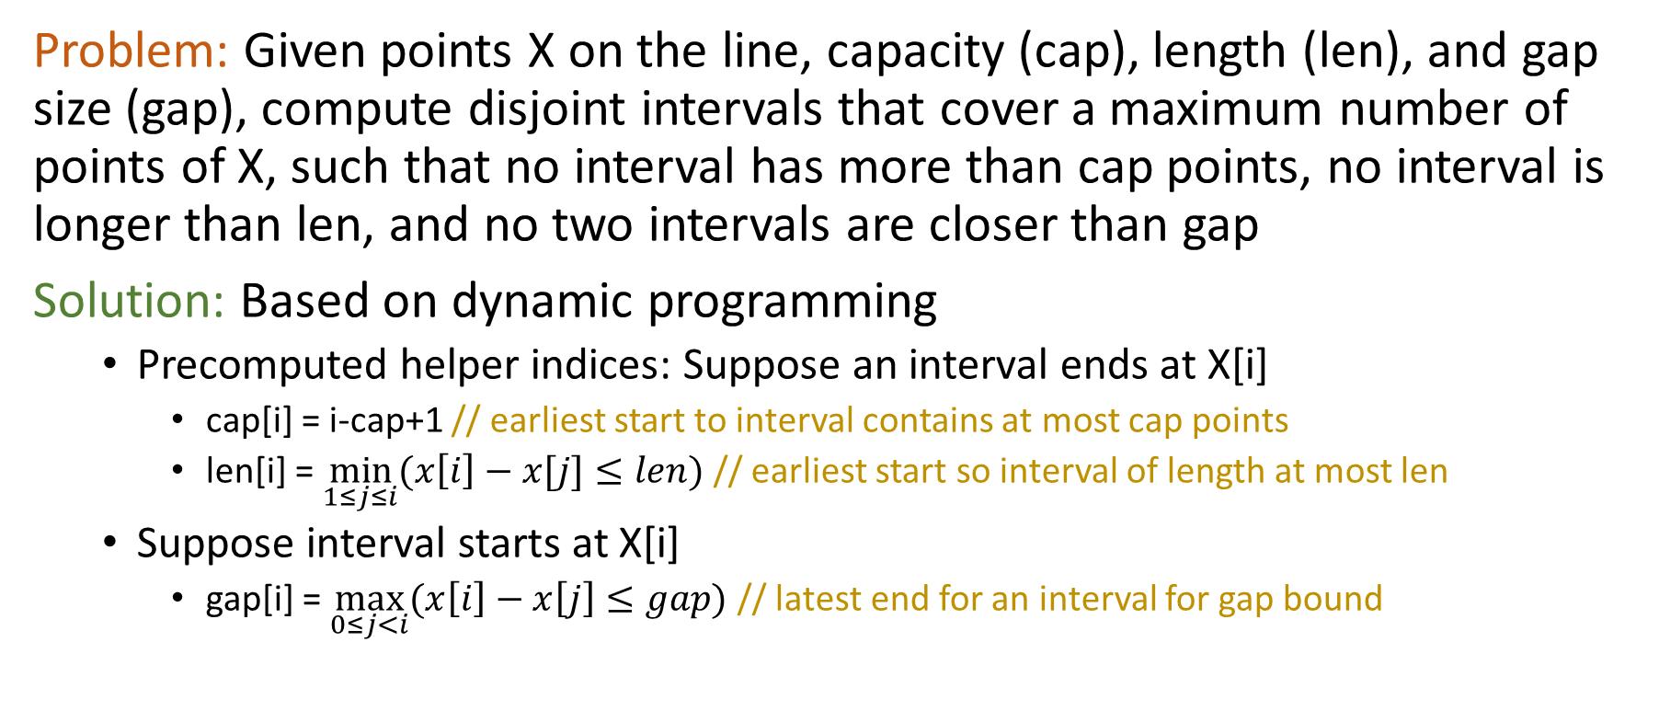
P9 – Starfish
Problem: Given points X on the line, capacity (cap), length (len), and gap size (gap), compute disjoint intervals that cover a maximum number of points of X, such that no interval has more than cap points, no interval is longer than len, and no two intervals are closer than gap
Solution: Based on dynamic programming
Precomputed helper indices: Suppose an interval ends at X[i]
cap[i] = i-cap+1 // earliest start to interval contains at most cap points
len[i] = $\min_{1≤j≤i}{(x\left[i\right]−x[j]≤len)}$ // earliest start so interval of length at most len
Suppose interval starts at X[i]
gap[i] = $\max_{0≤j<i}{(x\left[i\right]−x\left[j\right]≤gap)}$ // latest end for an interval for gap bound

Slide 17
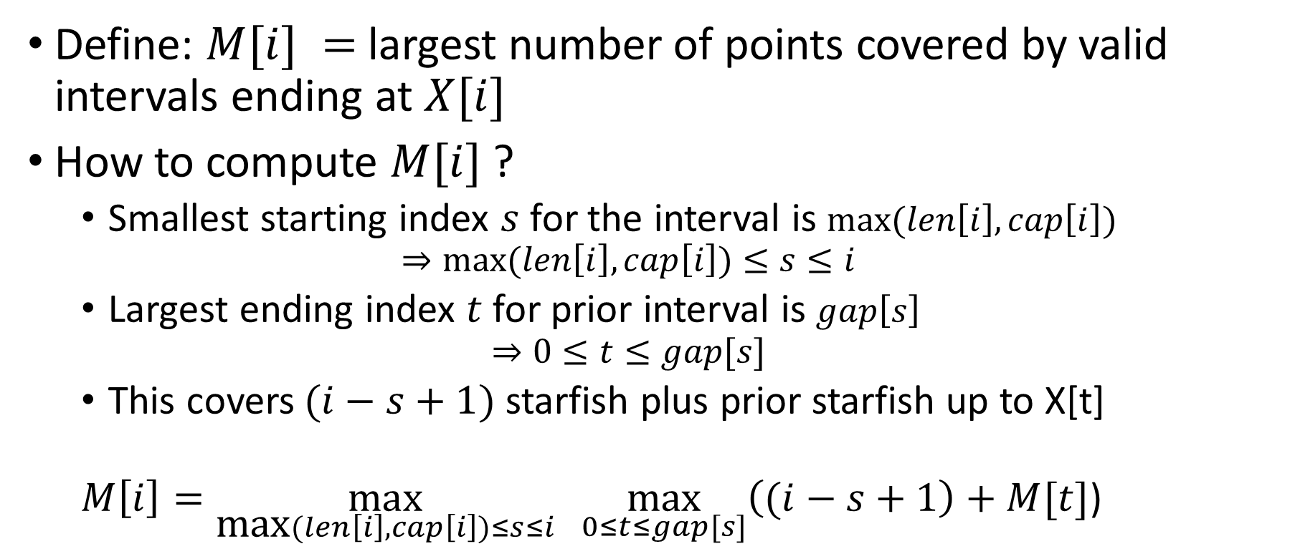
P9 – Starfish
Define: $M[i] =$largest number of points covered by valid intervals ending at $X[i]$
How to compute $M[i]$?
Smallest starting index $s$for the interval is $\text{max}{(len\left[i\right],cap\left[i\right])}$ $⇒\text{max}{(len\left[i\right],cap\left[i\right])≤s≤i}$
Largest ending index $t$ for prior interval is $gap\left[s\right]$ $⇒0{≤t≤gap[s]}$
This covers $(i−s+1)$starfish plus prior starfish up to X[t]
$M\left[i\right]=\max_{\text{max}{(len\left[i\right],cap\left[i\right])≤s≤i}}{\max_{0≤t≤gap[s]}\left((i−s+1\right)+M[t]}$)

